Slide 1

TOPIC
Idea/Approach Details
Ministry/Organization name : Central Warehousing Corporation (CWC)
Team Name : TECH : THE ELITE GROUP Team Leader Name : ISHAN GUPTA
College Code :
Problem Statement : 1. Low cost IT solution preferably around Internet of the things (IoT) sensor and IoT data integration to existing application software. The sensor is expected to auto capture the atmospheric moisture and temperature inside the warehouse. 2. Based on moisture and temperature data so captured, the software should do appropriate data analytics and send timely alert to concern officials of CWC for mitigation and remedial actions arising due to moisture and temperature inside the warehouse. 3. Additionally, IoT sensor can also capture fire, earthquake, etc. and can alert the respective nearest authority like Fire Station, Hospital, Police besides alerting CWC officials for mitigation.

Slide 2
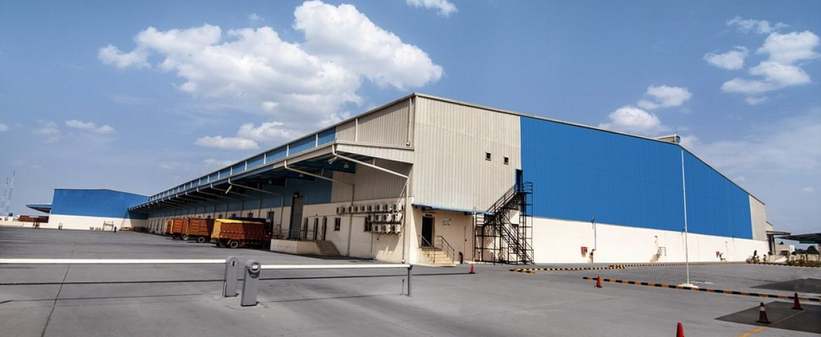

CENTRAL WAREHOUSING CORPORATION
A premier Warehousing Agency in India, established during 1957 providing logistics support to the agricultural sector, is one of the biggest public warehouse operators in the country offering logistics services to a diverse group of clients.
CWC is operating 422 Warehouses across the country with a storage capacity of 10.1 million tonnes providing warehousing services for a wide range of products ranging from agricultural produce to sophisticated industrial products.
Warehousing activities of CWC include food grain warehouses, industrial warehousing, custom bonded warehouses, container freight stations, inland clearance depots and air cargo complexes.
Apart from storage and handling, CWC also offers services in the area of clearing & forwarding, handling & transportation, procurement & distribution, disinfestation services, fumigation services and other ancillary activities.
CWC also offers consultancy services/ training for the construction of warehousing infrastructure to different agencies.

Slide 3




PROBLEM SOLUTION
Here we using Node MCU esp8266 to link between sensor and mobile using wireless communication .Here we are also using DHT11 (temperature and humidity) , Flame sensor (to detect fire in warehouse) ,Smoke sensor – MQ2 (to detect smoke of the fire ). The existing application software used is Blynk which helps to show data collected from DHT 11 sensor to the mobile . Also Blynk helps to send the timely alert about temperature and humidity to the CWC official.
With the help of Blynk application we also give the information about the fire(if fire sensor detect some response) to local fire station , police station and also to the related CWC official through twitter .

Slide 4
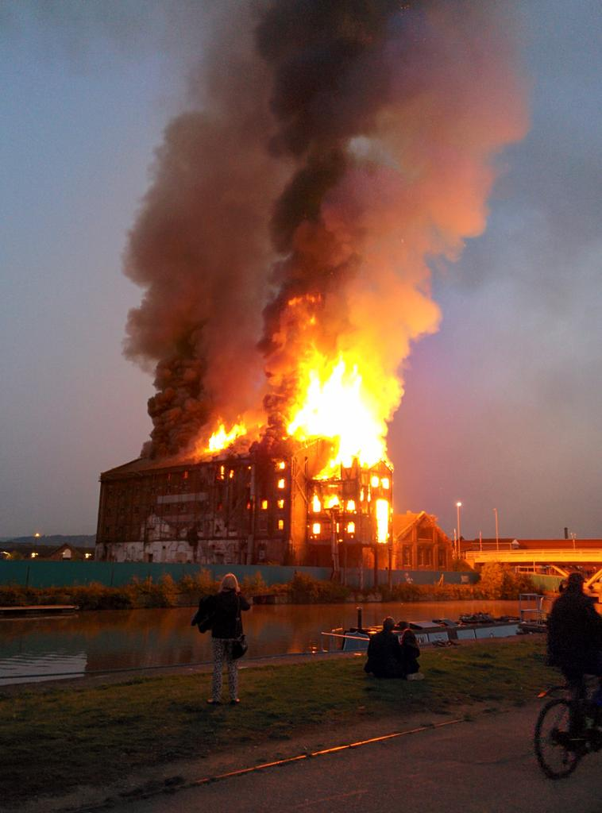
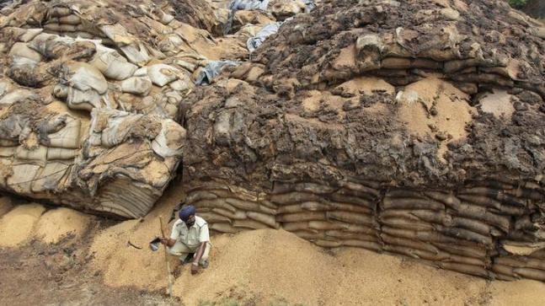
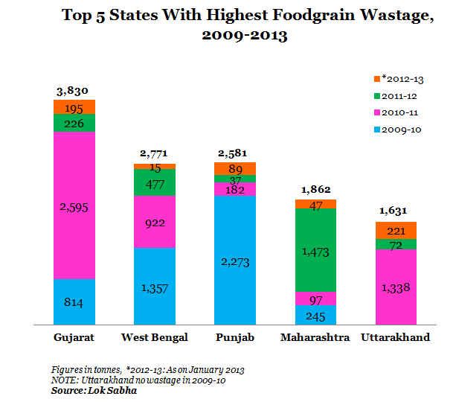
PROBLEMS ASSOCIATED TO WAREHOUSE
FIRE : DUE TO ELECTRICAL FAULTS .
DUE TO HUMAN ERRORS .
DUE TO THE PRESENCE OF FLAMMABLE ITEMS .
2. DECAY OF PRODUCT : DUE TO EXCESSIVE HUMIDITY IN WAREHOUSE.
DUE TO UNFAVOURABLE TEMP. CHANGES .

Slide 5
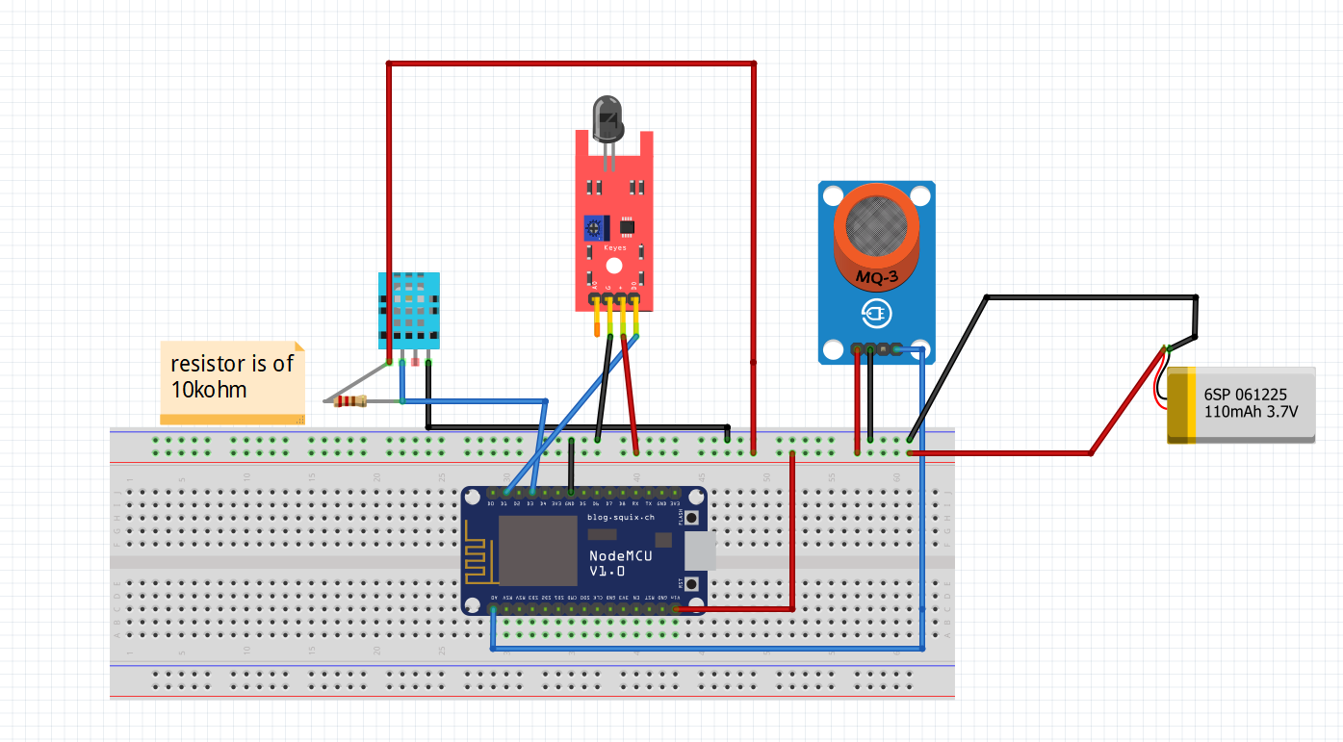
CIRCUIT DIAGRAM :

Slide 6
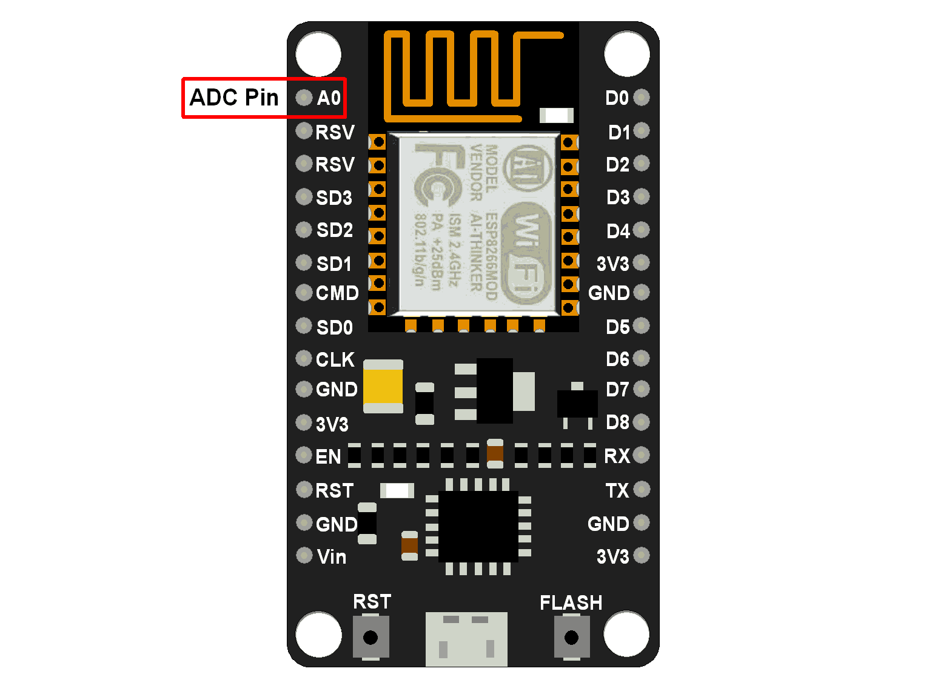
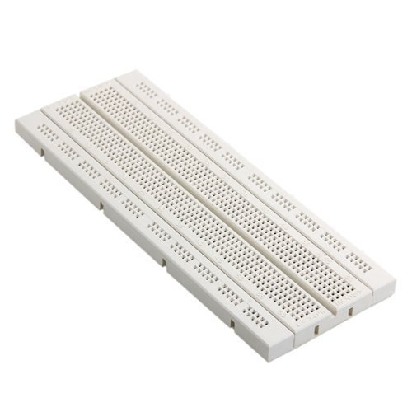
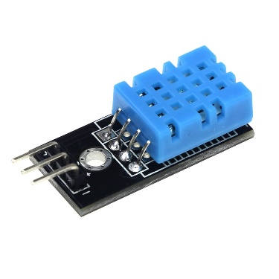
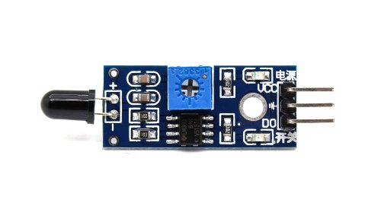

HARDWARE USED:
NODE MCU 1.0V
BREADBOARD
DHT11
FLAME SENSOR
SMOKE SENSOR
WIRES
7. RELAY

Slide 7

SOFTWARE USED:
ARDUINO IDE
2. BLYNK APP

Slide 8
USED CASES:

Slide 9
DEPENDENCIES AND SHOW STOPPERS OF THE PROGRAM
DEPENDENCIES
SHOW STOPPERS
Timely Alerts and Automatic
Temperature Regulation
Twitter account
Smartphone with Blynk App
Internet connection(minimum 2G)

